Slide 1
System maintenance
system maintenance..
How do you conduct maintenance?
Types of maintenance..
Cost of maintenance..
How do you manage it?
rajesh adhikari

Slide 2
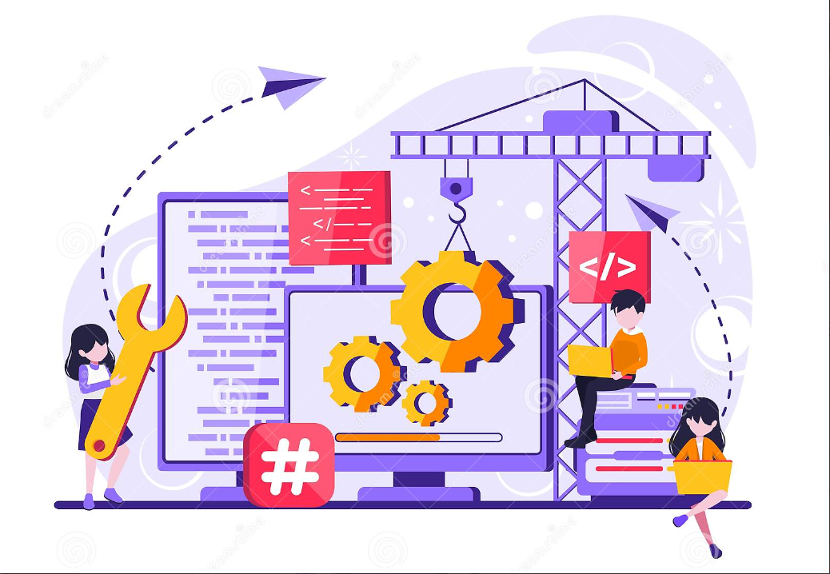
What is system maintenance?

Slide 3
System Maintenance
System maintenance is an umbrella term that encompasses various forms of computer maintenance needed to keep a system running.
The process of monitoring, evaluating, and modifying of existing information systems to make required or desirable improvements may be termed as System Maintenance.
In simpler terms, System Maintenance is the process of modifying a system after it has been delivered to the customer.

Slide 4
Basic knowledge
A significant portion of an organization‘s budget for information systems does not go to the development of new systems but to the maintenance of existing systems.
We describe various types of maintenance, factors influencing the complexity and cost of maintenance, alternatives for managing maintenance, and the role of automated development tools during maintenance.
System maintenance is an ongoing activity, which covers a wide variety of activities, including removing program and design errors, updating documentation and test data and updating user support.

Slide 5
Major activities that occur within maintenance
There are four major activities occur within maintenance :
Obtaining maintenance requests
Transforming request into changes
Designing changes
Implementing changes

Slide 6
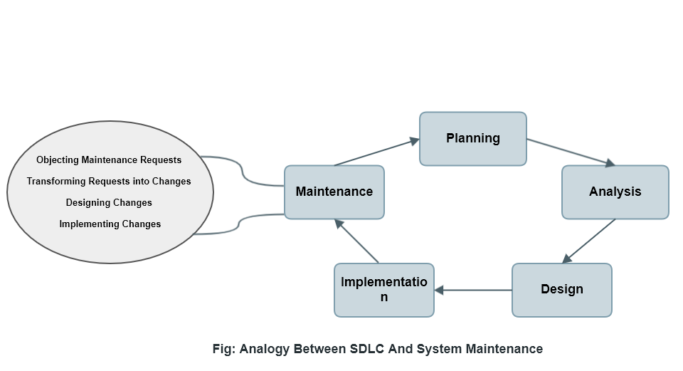
Analogy between sdlc and system management

Slide 7
Conducting maintenance
Maintenance process vary considerably depending on the type of system being maintained, the development process used in the organization and the people involved in the process.
Maintenance is triggered by change requests from customers or marketing requirements.
Changes are normally batched and implemented in a new release of the system.
Programs sometimes need to be repaired without a complete process iteration.
. but this is dangerous as it leads to documentation and programs getting out of step.
The cost and impact of these changes are assed to see how much the system is affected and how much it might cost to implement the change.
If the proposed changes are accepted, new release of system is planned.

Slide 8
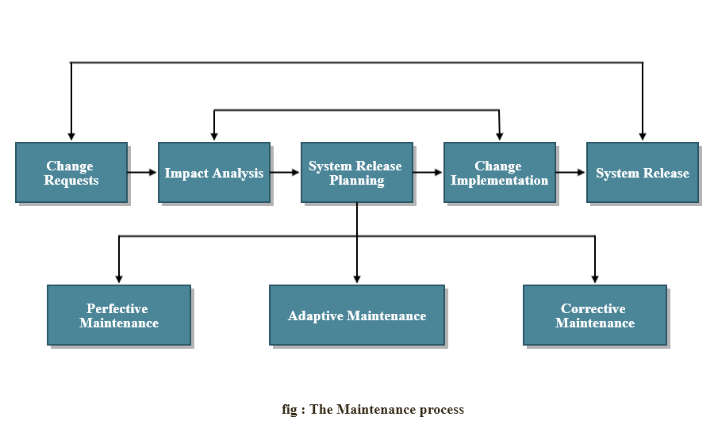
The maintenance process

Slide 9
Types of maintenance
By maintenance, we mean the fixing or enhancing of an information system. You can perform several types of maintenance on an information system.
Corrective maintenance
Corrective maintenance refers to changes made to repair defects in the design, coding, or implementation of the system.
For example, if you purchase a new home, corrective maintenance would involve repairs made to things that had never worked as designed, such as a faulty electrical outlet or misaligned door.
Corrective maintenance adds little or no value to the organization; it simply focuses on removing defects from an existing system without adding new functionality.

Slide 10
Cont.…
Adaptive maintenance
Adaptive maintenance involves making changes to an information system to evolve its functionality to changing business needs or to migrate it to a different operating environment.
Within a home, adaptive maintenance might be adding storm windows to improve its energy efficiency.
Adaptive maintenance is usually less urgent than corrective maintenance because business and technical changes typically occur over some period of time.
Contrary to corrective maintenance, adaptive maintenance is generally a small part of an organization‘s maintenance effort but does add value to the organization.

Slide 11
Cont.…
Perfective maintenance
Perfective maintenance involves making enhancements to improve processing performance, interface usability, or to add desired, but not necessarily required, system features.
In our home example, perfective maintenance would be adding a new room. Many system professionals feel that perfective maintenance is not really maintenance but new development.

Slide 12
Cont.…
Preventive maintenance
Preventive maintenance involves changes made to a system to reduce the chance of future system failure.
In our home example, preventive maintenance could be painting the exterior to better protect the home from severe weather conditions.
Preventive maintenance activities can lead to corrective maintenance activities if not carefully designed and implemented.

Slide 13
The Cost of maintenance
The term maintenance expense refers to any cost incurred by an individual or business to keep their assets in good working condition. These costs may be spent for the general maintenance of items like running anti-virus software on computer systems or they may be used for repairs such as fixing a car or machinery.
Factors influencing maintenance costs
Latent defects: number of unknown errors existing in system after it is installed.
Number of customers for a given system: in general, the greater the number of customers, the greater the maintenance costs.

Slide 14
Cont.…
Quantity of system documentation: high-quality documentation leads reduction in the system maintenance effort when compare d with average-quality documentation.
Maintenance personnel: some organizations hire highly skilled programmers for maintenance which directly leads to high cost of maintenance.
Well-structured programs: well-designed system are easier to understand and fix.

Slide 15
Managing maintenance
Maintenance management is the process of maintaining a company’s assets and resources.
The purpose is to ensure that production proceeds efficiently and that resources are used effectively.
Maintenance management is one of those aspects of managing a company that is usually not explored in depth.
it helps companies to maintain their resources while controlling time and costs to ensure maximum efficiency of the manufacturing process, the utilities and related facilities.
It is a tool that helps to secure a reliable and satisfactory quality of the production, safety for employees and protection for the environment.

Slide 16
We will be discussing about managing maintenance using following topics:
Managing maintenance personnel
Measuring maintenance effectiveness
to measure effectiveness, you must measure the following factors:
Number of failures
Time between each failures
Type of failure
Controlling maintenance requests
Role of case in maintenance

Slide 17
Thank you
Prepared by
Rajesh adhikari

